Slide 1
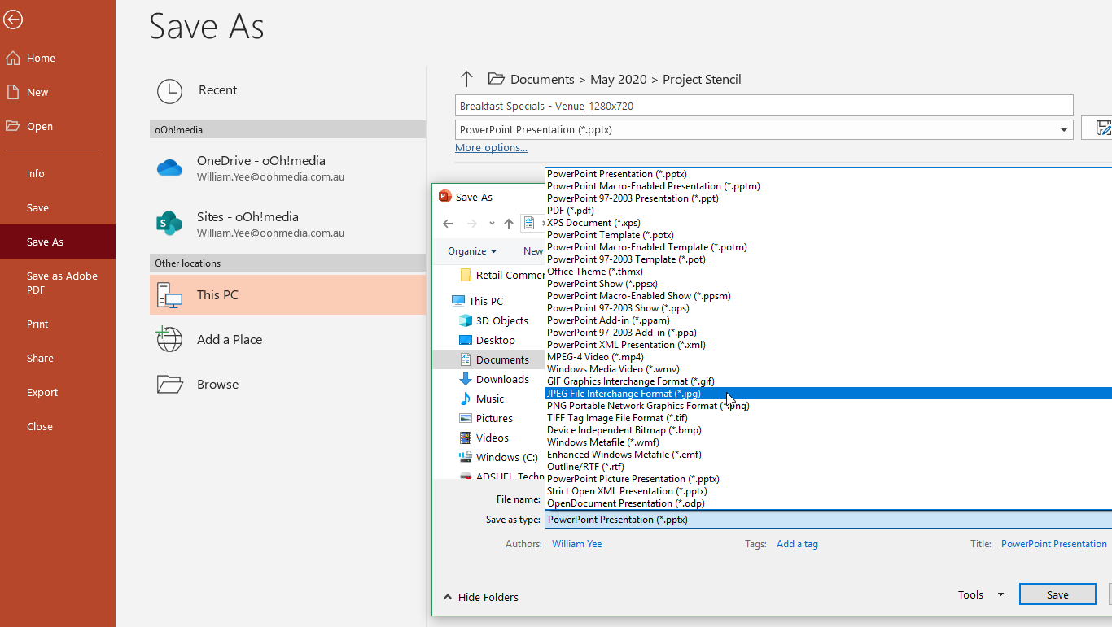
Saving Your Designs
Once you have selected your template slide, delete the remaining slides you do not wish to use
Edit, design and create your content/special(s)
Go to FILE → Save As → Browse: and select a location you wish to save the file
Rename your file and date it
Change the type of file you are saving to a ‘JPG’
Hit SAVE → ‘Just This One’
You now have the file ready to upload in the correct dimensions and format!

Slide 2
CREATIVES TO FIT THE DIMENSIONS OF
1080 X 1920px

Slide 3
LOGO
BUILDING NAME
BUILDING NOTICE
Notice Information
BUILDING CONTACT DETAILS

Slide 4
LOGO
BUILDING NOTICE
Notice Information
BUILDING CONTACT DETAILS

Slide 5
BUILDING NOTICE
Notice Information
BUILDING CONTACT DETAILS
LOGO

Slide 6
BUILDING NOTICE
BUILDING
NOTICE
INFORMATION
BUILDING CONTACT DETAILS
LOGO

Slide 7
BUILDING NOTICE
Notice Information
REPLACE WITH PHOTO/PICTURE
BUILDING CONTACT DETAILS
LOGO

Slide 8
REPLACE WITH PHOTO/PICTURE
BUILDING NOTICE
Notice Information
BUILDING CONTACT DETAILS
LOGO

Slide 9
REPLACE WITH PHOTO/PICTURE
BUILDING
NOTICE
Notice Information
LOGO

Slide 10
REPLACE WITH PHOTO/PICTURE
BUILDING
NOTICE
Notice Information
LOGO

